Slide 1
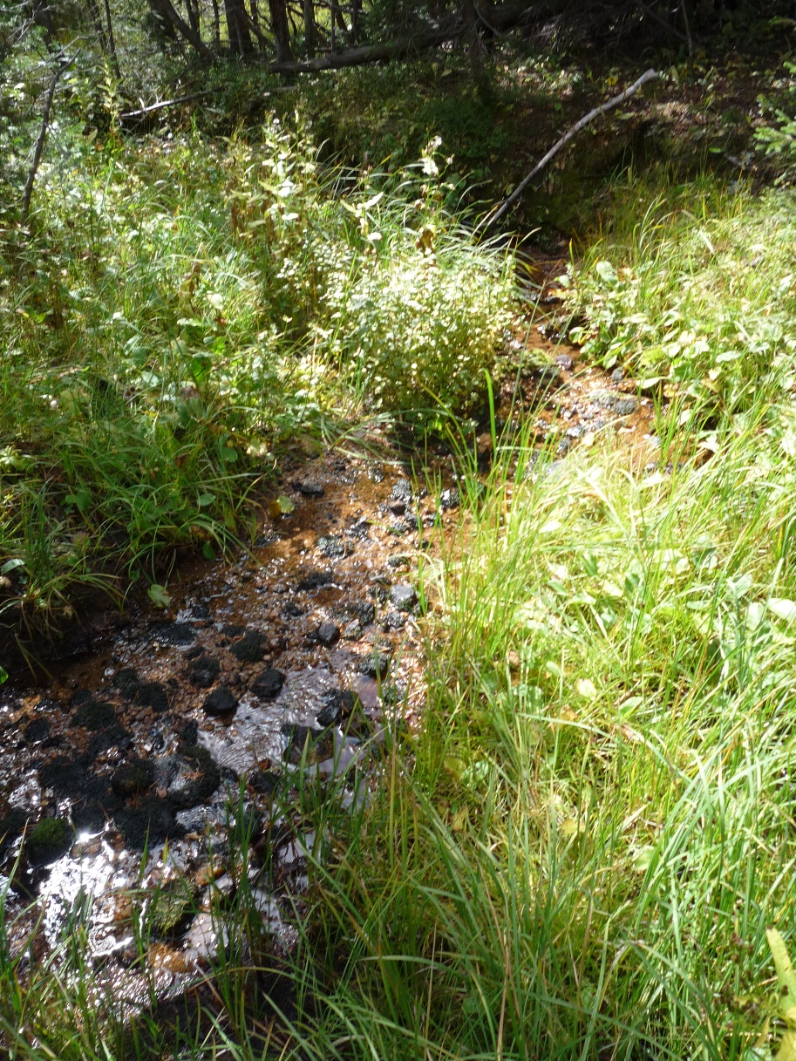
Chapter 4 Part 2
Entity Relationship (ER) Modeling
The slides in this presentation have been adapted from slides provided with the textbook, Database Systems: Design, Implementation, and Management,
12E, Cornel and Morris, Copyright © 2017 Cengage Learning.

Slide 2
Learning Objectives
Describe the concepts of existence, dependence, weak/strong relationships
Explain the concept of relationship degree using examples
Create examples of data that implement recursive relationships
Copyright © 2017 Cengage Learning
2

Slide 3
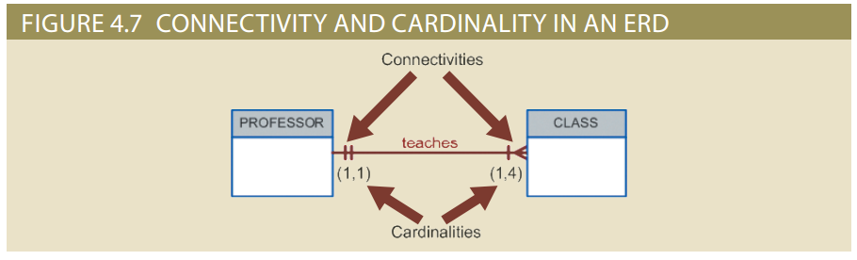
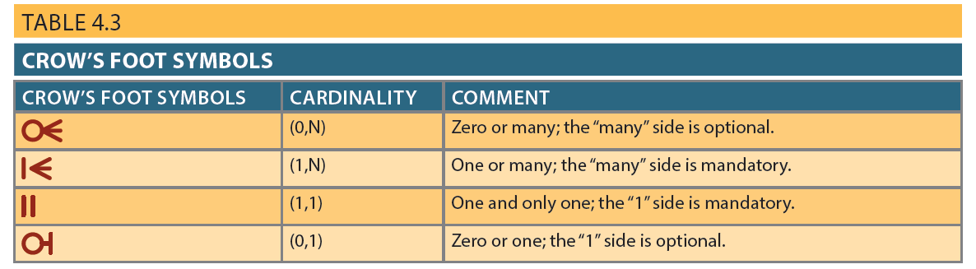
Figure 4.7 - Connectivity and Cardinality in an ERD
Copyright © 2017 Cengage Learning
3

Slide 4
Existence Dependence
Existence independence
Entity can exist apart from one or more related entities
Sometimes such an entity is referred to as a strong or regular entity
E.g., instance of EMPLOYEE can exist before being assigned to/associated with an instance of PROJECT
Existence dependence
Instance of the entity exists in database only when it is associated with an existing instance in another entity
E.g., instance of EMPLOYEE_DEPENDENT can only exist if there is an instance of EMPLOYEE.
Copyright © 2017 Cengage Learning
4

Slide 5
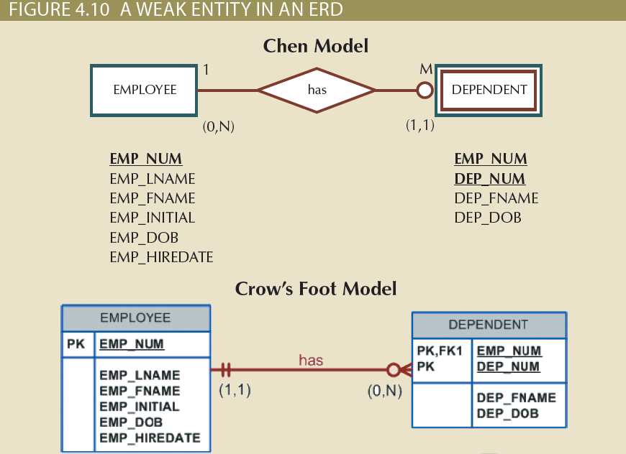
Figure 4.10 - A Weak Entity in an ERD
Copyright © 2017 Cengage Learning
5

Slide 6
Relationship Strength
Weak (non-identifying) relationships
Exists if PK of related entity does not contain PK component of strong entity
Strong (identifying) relationships
Exists when PK of related entity contains PK component of strong entity
Of course, both are implemented by foreign keys, the only difference is whether the foreign key is part of the primary key or not.
Copyright © 2017 Cengage Learning
6

Slide 7
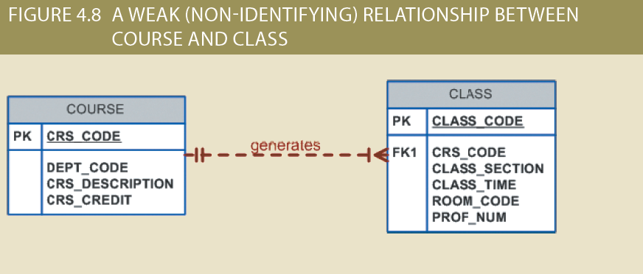
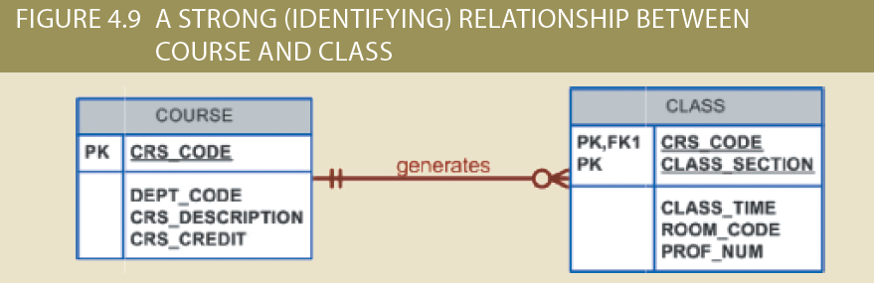
Weak vs Strong Relationships
Copyright © 2017 Cengage Learning
7

Slide 8
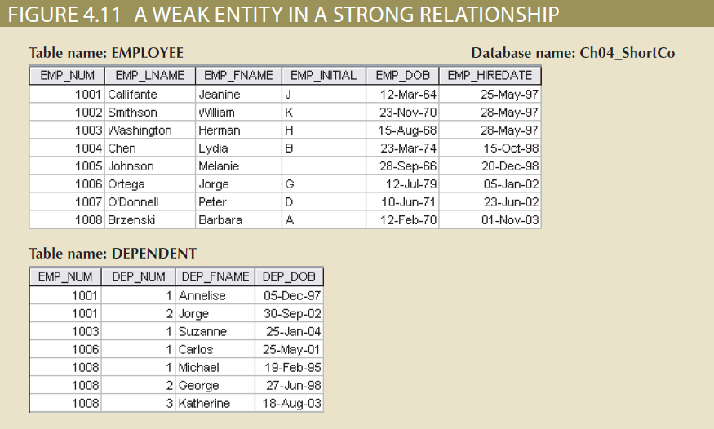
Weak Entity in a Strong Relationship
Copyright © 2017 Cengage Learning
8

Slide 9
Relationship Participation
Optional participation
One entity occurrence/instance does not require corresponding entity occurrence/instance in particular relationship
Often artifact of the order of arrival of instances to database
Mandatory participation
One entity occurrence requires corresponding entity occurrence in particular relationship
Copyright © 2017 Cengage Learning
9

Slide 10
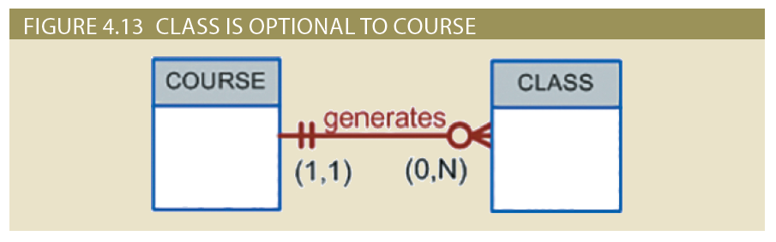
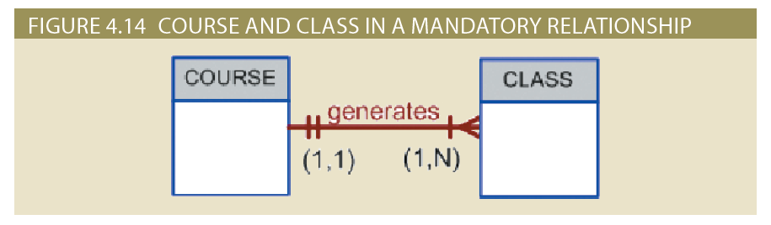
CLASS is Optional or Mandatory? Course is Mandatory
Copyright © 2017 Cengage Learning
10

Slide 11
Relationship Degree
Indicates the number of entities or participants associated with a relationship
Binary relationship: Two entities are associated
Ternary relationship: Three entities are associated
Unary relationship: Relationship is among instances of a single entity
Recursive relationship: one instance of an entity is related to many instances of the same entity
E.g., EMPLOYEE entity with attribute ManagerIdFK, contains the key value of the instance of their manager
Copyright © 2017 Cengage Learning
11

Slide 12
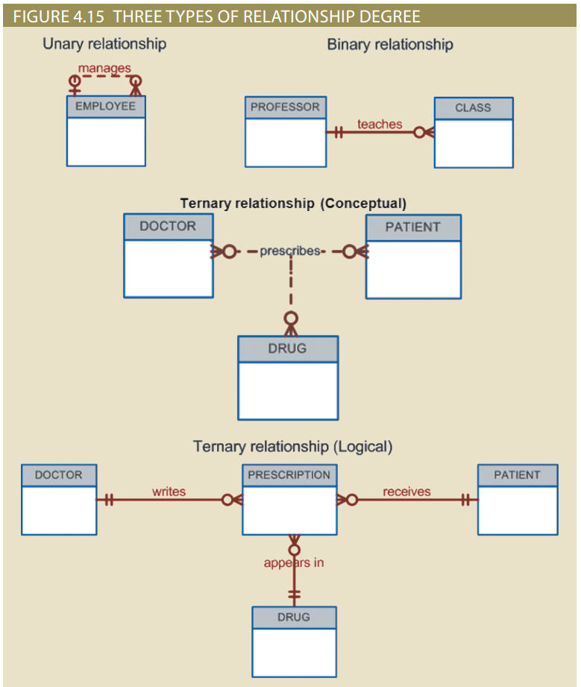
Figure 4.15 - Three Types of Relationship Degree
Copyright © 2017 Cengage Learning
12

Slide 13
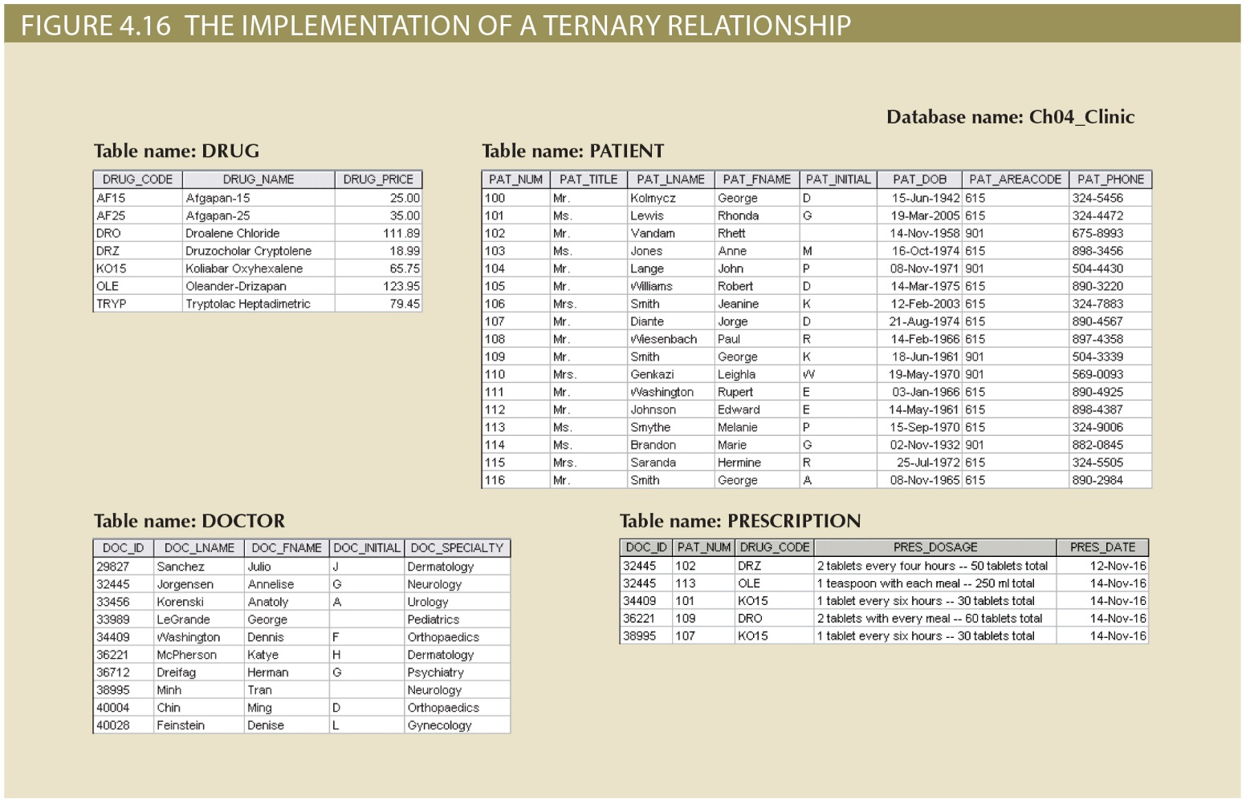
Copyright © 2017 Cengage Learning
13

Slide 14
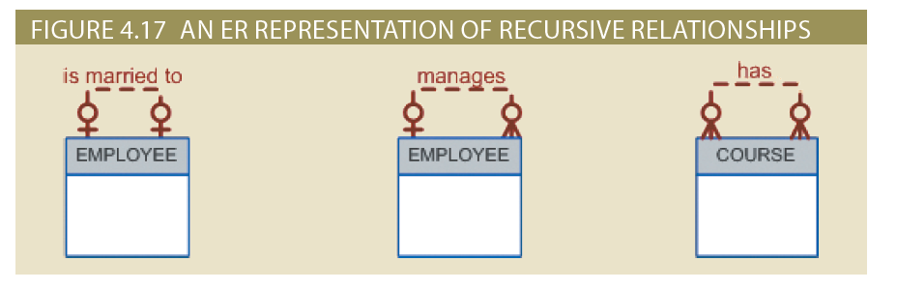
Recursive Relationships
Relationship that exist between occurrences of the same entity set
Naturally found within unary relationship
Copyright © 2017 Cengage Learning
14

Slide 15
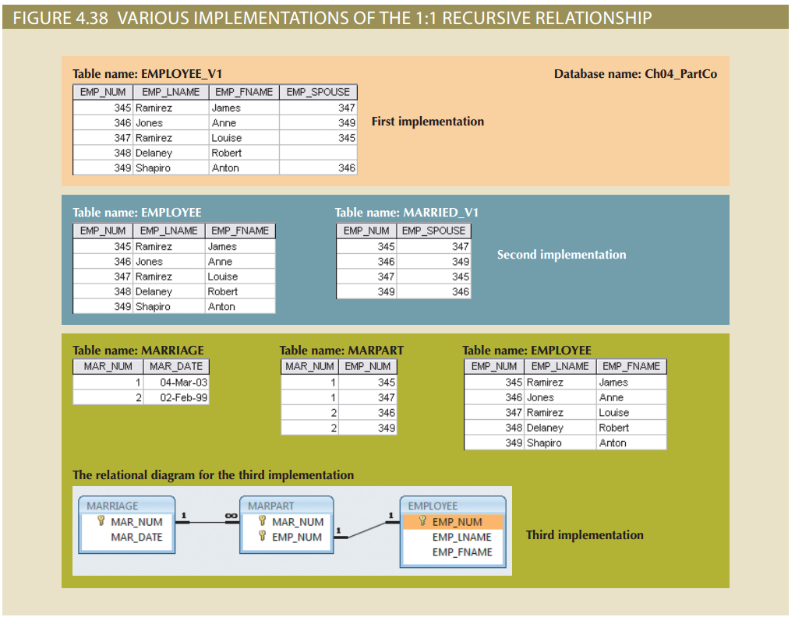
Copyright © 2017 Cengage Learning
15

Slide 16
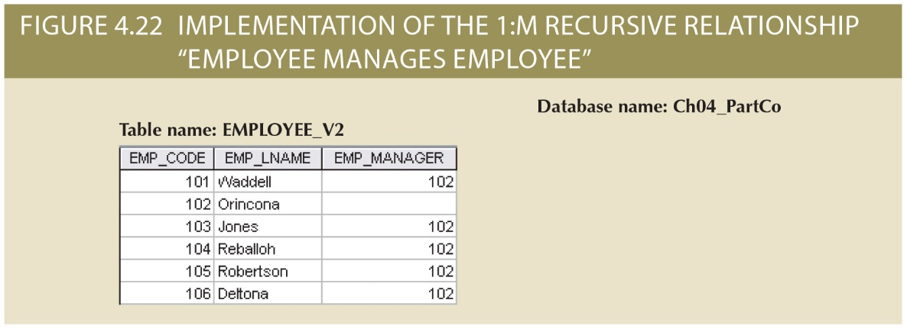
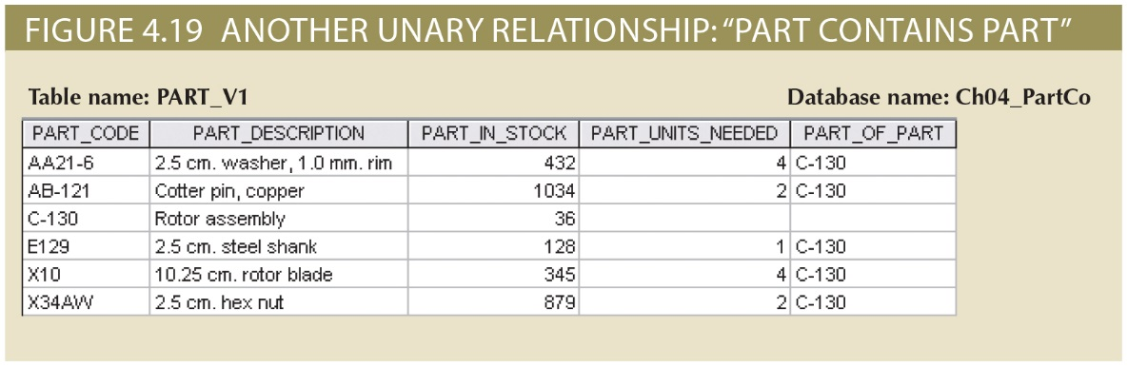
Recursive Relationship Examples
Copyright © 2017 Cengage Learning
16

Slide 17
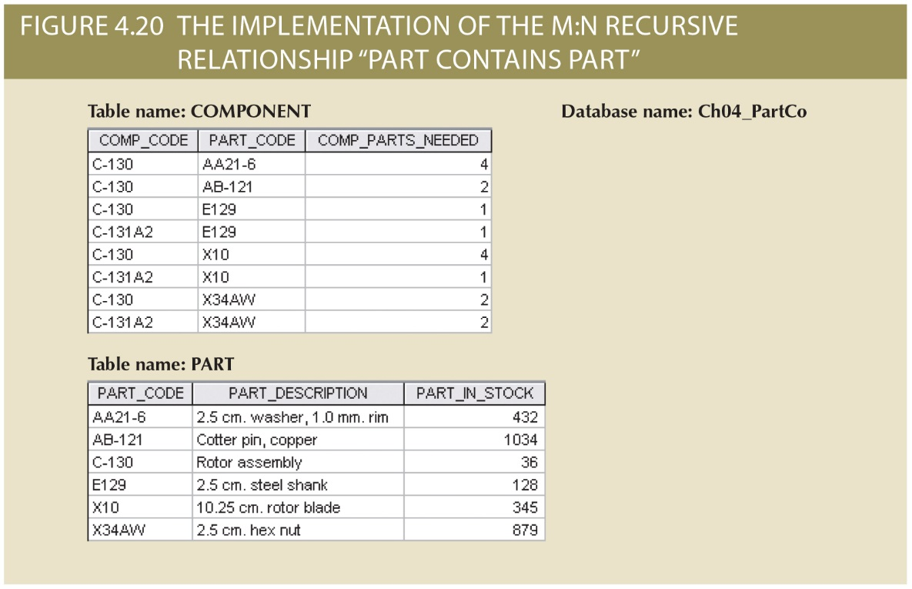
M:N Recursive Relationship of Components and Parts
Copyright © 2017 Cengage Learning
17

Slide 18
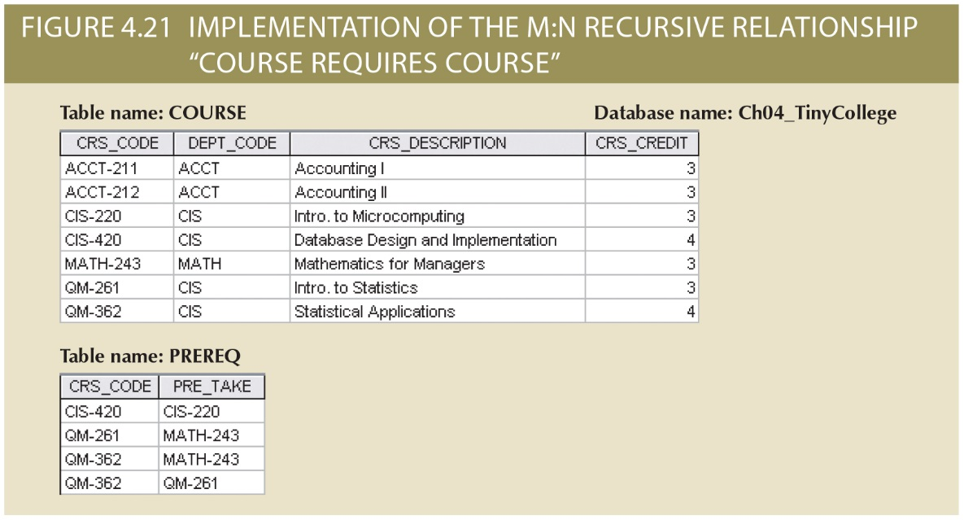
M:N Recursive Relationship of Course Prereqs
Copyright © 2017 Cengage Learning
18

Slide 19
Developing an ER Diagram
Create a detailed narrative (Use Cases) of the organization’s description of operations
Identify business rules based on the descriptions
Identify main entities and relationships from the business rules
Develop the initial ERD
Identify the attributes and primary keys that adequately describe entities
Revise and review ERD
Copyright © 2017 Cengage Learning
19

Slide 20
Database Design Challenges: Conflicting Goals
Database designers must make design compromises
Conflicting goals: design standards, processing speed, information requirements
Important to meet logical requirements and design conventions
Design is of little value unless it delivers all specified query and reporting requirements
Some design and implementation problems do not yield “clean” solutions
Copyright © 2017 Cengage Learning
20

Slide 21
Summary
Existence dependence and weak/strong relationships
Relationship degree, e.g., binary, ternary, unary, others?
Recursive relationships can represent hierarchical knowledge, e.g., part made of parts
Copyright © 2017 Cengage Learning
21

Slide 22
Task
Create an ERD and example tables for an example of a ternary relationship that is not in the book.
Explain why a M:N unary recursive relationship needs to have an associative entity
Copyright © 2017 Cengage Learning
22

